Slide 1


05
February 13-19, 2024
Container Types, Sorting Algorithms, Binary Search
Notes:
https://pixabay.com/en/man-reading-touchscreen-blog-791049/#_=_

Slide 2
Announcements
Project 2 is due on February 22nd at 11:59 PM
Lab 4 autograder and quiz are due on February 19th at 11:59 PM
Lab 5 handwritten is due IN LAB by February 19th. DO NOT CALL SORT()!!!
Lab 5 quiz is due on February 26th at 11:59 PM
No autograder portion (quiz is worth 15 points)
Midterm: Tuesday, March 5th from 7:00 PM to 9:00 PM
If you need an alternate time, or SSD accommodations, you must complete the alternate exam request form as soon as possible!
No labs until March 12th!
Notes:
Review all your lecture and lab notes!
Understand how to do all the lab coding exercises and projects!

Slide 3
Agenda
Midterm Topics
Container Types
Sorting Algorithms
Binary Search
Handwritten Problem

Slide 4
Midterm Topics

Slide 5
Midterm Topics to Review
(Asymptotic) Complexity and Runtime Analysis, Math Foundations
Recursion and the Master Theorem
Container Data Structures and Array-Based Containers
The Standard Template Library (STL)
Stacks, Queues, and Priority Queue ADTs
Ordered Arrays and Related Algorithms
Set Operations (Union/Intersection) and Union-Find
Elementary Sorts and Library-Implemented Sorts
Quicksort and Mergesort
Heaps and Heapsort
Linear-Time Sorting Algorithms

Slide 6
Additional Reminders
Review all your lecture and lab notes!
Understand how to do all the lab coding exercises and projects!
Check out Piazza @1137 for additional (leetcode-style) FRQ practice
Midterm topics include sorting, binary search, union-find, stacks/queues, linked list, and array
Not required for success, simply a resource that’s available
Bring a pencil, eraser, MCard, and an 8.5”x11” note sheet (both sides OK)
No calculators or other electronic devices

Slide 7
Types of Containers

Slide 8
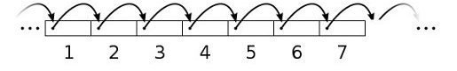
Types of Containers
Searchable
containers that support find()
searchable: vector, deque, list; not searchable: stack, queue
Sequential
allows iteration over elements in some order
sequential: vector, deque, list; not sequential: stack, queue

Slide 9
Types of Containers
Sorted
elements are stored in some pre-defined order based on a sorting criteria
does not support insert() in any location
convenient if you want to search the container
examples: map, set
Ordered
maintains current order
supports insert() at any location
insertion and deletion do not disrupt the relative ordering of other elements in the container
examples: vector, deque, list

Slide 10
Types of Containers
Ordered Containers
Sorted Containers
Data Structure | insertAfter() | operator[ ] | delete()
Array | O(n) | O(1) | O(n)
Linked-list | O(1) | O(n) | O(1)
Data Structure | find() | operator[ ] | delete()
Array | O(log n) | O(1) | O(n)
Linked-list | O(n) | O(n) | O(1)

Slide 11
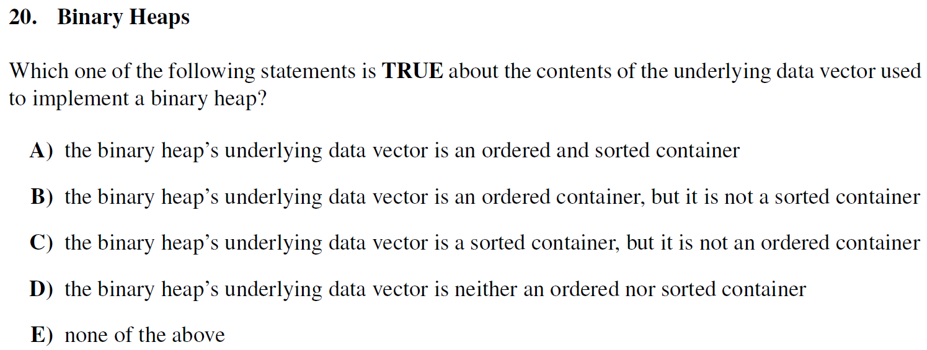
Types of Containers
Midterm Exam Question (Fall 2018)
Notes:
173/730 - 24% accuracy rate!

Slide 12
Types of Containers
Midterm Exam Question (Fall 2018)

Slide 13
Types of Containers
Why is the answer (D)?
The binary heap’s data vector is used to represent a binary tree. The relationship between the “nodes” is only that no parent is lower in priority than any of its descendants. There are multiple array representations of the exact same binary heap.
{1,2,3,4,5,6} // a valid min-heap
{1,3,2,6,5,4} // an identical heap
The variations above show that the binary heap is not sorted, as the data in the vector does not have to be in a specific order in order for the binary heap to be valid.
To show that it is not ordered, we have to determine a situation where adding an element changes the relative ordering of elements already in the heap.

Slide 14
Types of Containers
Why is the answer (D)?
Current array representation: {8,2,4}
8
2
4
8
2
4

Slide 15
Types of Containers
Why is the answer (D)?
Current array representation: {8,2,4}
Let’s add the element 9 to this binary heap!
8
2
4
8
2
4

Slide 16
Types of Containers
Why is the answer (D)?
Current array representation: {8,2,4}
Let’s add the element 9 to this binary heap!
8
2
4
9
8
2
4
9

Slide 17
Types of Containers
Why is the answer (D)?
Current array representation: {8,2,4}
Let’s add the element 9 to this binary heap!
Fix the heap invariant!
8
2
4
9
8
2
4
9

Slide 18
Types of Containers
Why is the answer (D)?
Current array representation: {8,2,4}
Let’s add the element 9 to this binary heap!
Fix the heap invariant!
8
9
4
2
8
9
4
2

Slide 19
Types of Containers
Why is the answer (D)?
Current array representation: {8,2,4}
Let’s add the element 9 to this binary heap!
Fix the heap invariant!
9
8
4
2
9
8
4
2

Slide 20
Types of Containers
Why is the answer (D)?
Current array representation: {8,2,4}
Let’s add the element 9 to this binary heap!
Fix the heap invariant!
New array representation: {9,8,4,2}
9
8
4
2
9
8
4
2

Slide 21
Types of Containers
Why is the answer (D)?
Current array representation: {8,2,4}
Let’s add the element 9 to this binary heap!
Fix the heap invariant!
New array representation: {9,8,4,2}
Notice how adding 9 to this binary heap changed the relative ordering of the other elements! Before the insertion, 2 was before 4 in the array. However, after 9 was added, 2 is now after 4 in the array! This shows that the binary heap is not ordered.
9
8
4
2
9
8
4
2

Slide 22
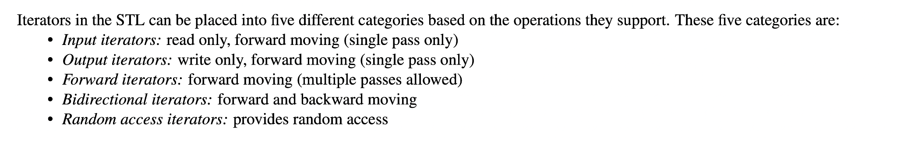
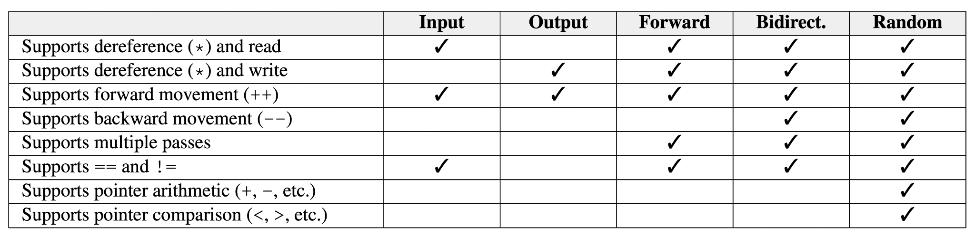
Types of Iterators
Understand the differences between different types of iterators
Further reading here: https://ajzhou.gitlab.io/eecs281/notes/chapter11/
Notes:
PUT THIS ON YOUR NOTE SHEET!!!

Slide 23
Sorting Algorithms

Slide 24
Sorting Algorithms
What to consider?
time complexity
space complexity
recursion
is it tail recursive?
if not, what is the stack depth?
stability
does it preserve the original order of elements that are equal?
adaptability
does it perform optimizations based on the order the elements are already in?

Slide 25
Overview of Sorts
Elementary sorts:
bubble sort
selection sort
insertion sort
More advanced sorts:
mergesort
quicksort
heapsort
counting sort
The following website is a great resource for visualizing these sorts!
https://visualgo.net/en

Slide 26
Bubble Sort

Slide 27

Bubble Sort
If you’re ever asked a sorting question during an interview...

Slide 28
Bubble Sort
Characteristics of bubble sort:
Not used in practice because it is inefficient for large datasets.
Algorithm: Repeatedly step through list to be sorted, comparing each pair of adjacent items and swapping if they are in the wrong order. Each time pass through a smaller section of the list until no more swaps are needed.
Stable because swaps only happen for elements with different values.
Adaptive bubble sort accomplishes best-case Ω(n) runtime: keep a boolean “swap” flag to indicate if any swaps were made during each pass of the array - if not, then the array is already sorted!
Best Case | Average Case | Worst Case | Memory | Stable?
Ω(n) | Θ(n²) | O(n²) | O(1) | Yes

Slide 29








Bubble Sort
Bubble sort in action:
See full lab 5 slides for the complete animation

Slide 30
Selection Sort

Slide 31
Selection Sort
Characteristics of selection sort:
Good when auxiliary memory is limited.
Algorithm: divide input list into sub-list of sorted items and sub-list of unsorted items. Add the smallest non-selected item to the back of the sorted portion (usually by swapping by whatever was there). This increases the sorted portion’s size. Repeat until the whole array is sorted.
in other words, find the smallest element in the list and swap with the first position, find the second smallest element and swap with second position…
Additional memory can make the sort stable (break ties using original index)
Best Case | Average Case | Worst Case | Memory | Stable?
Ω(n²) | Θ(n²) | O(n²) | O(1) | No*

Slide 32
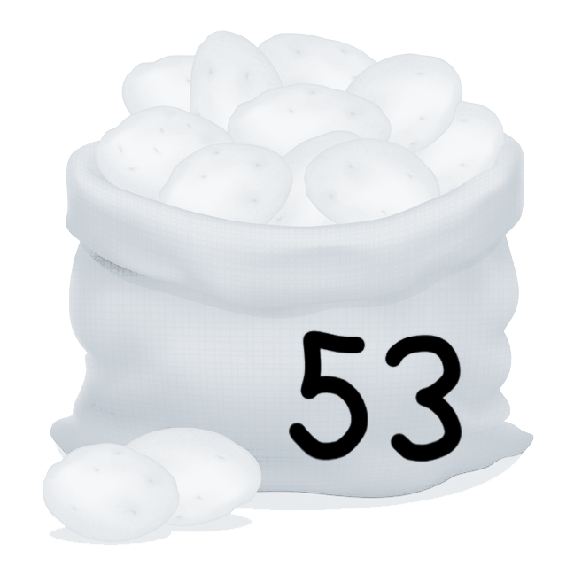
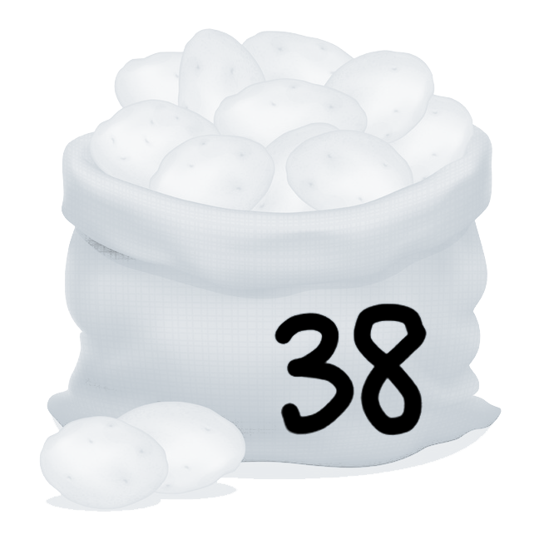
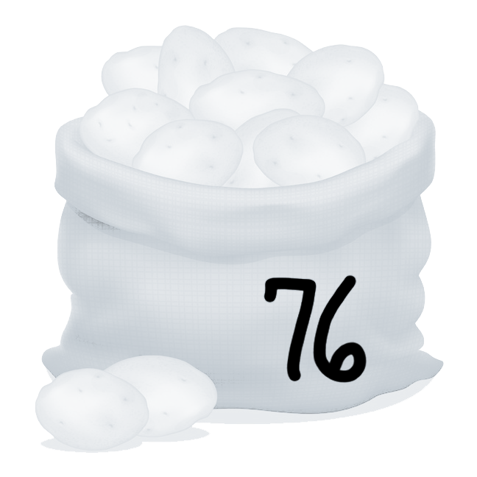
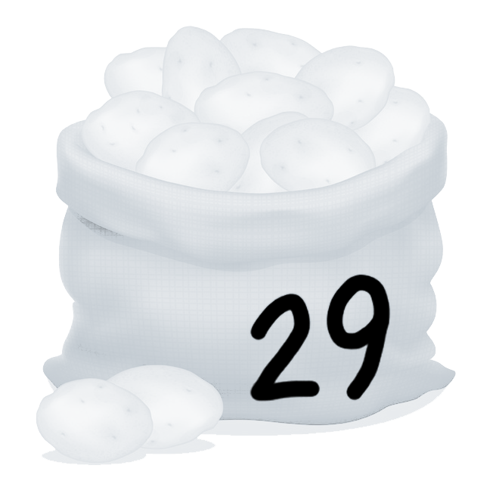
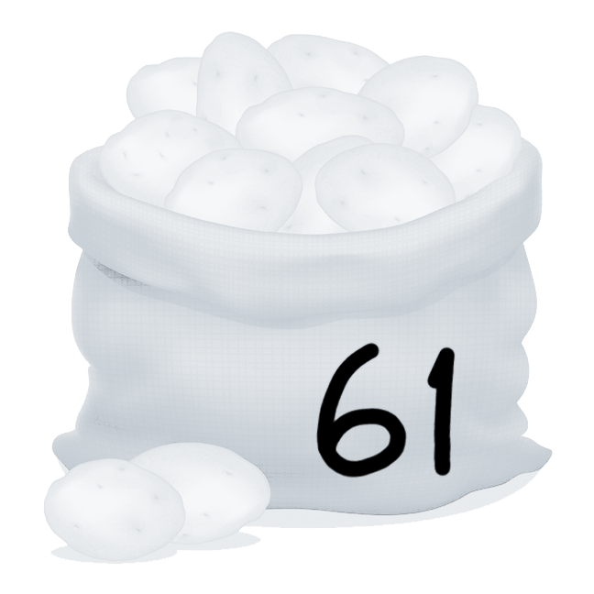
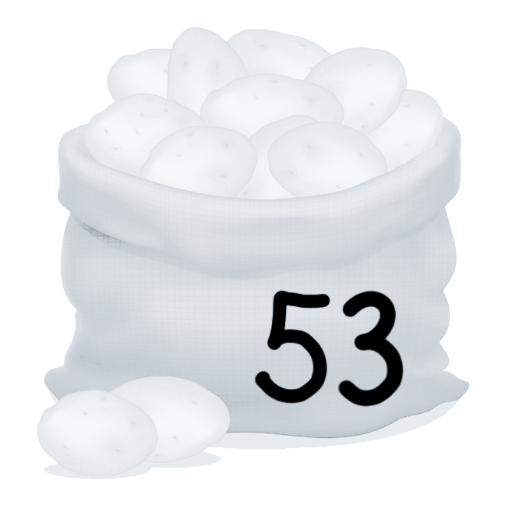
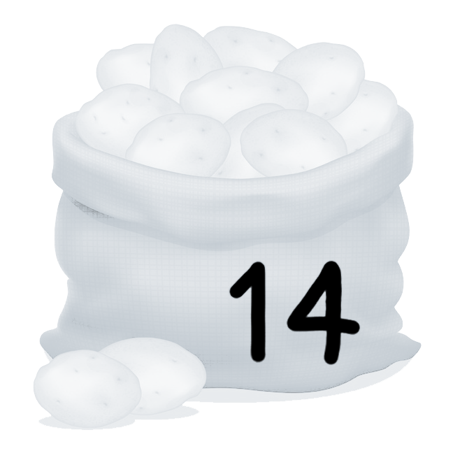
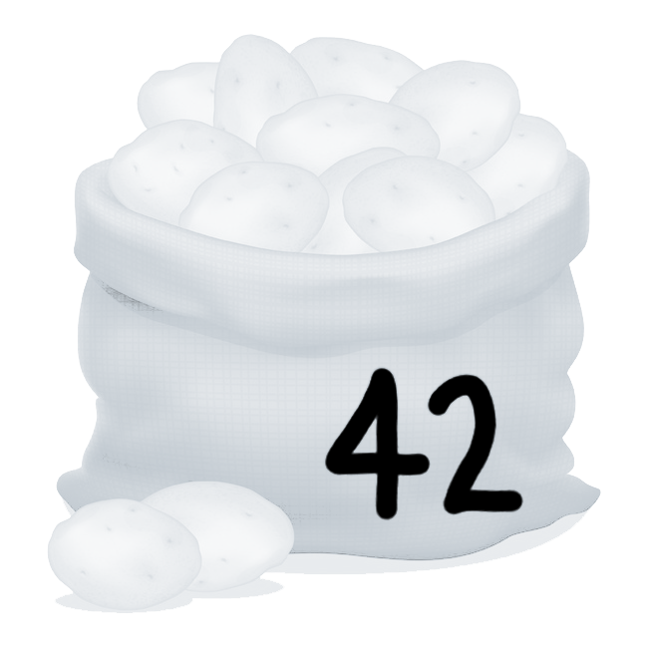
Selection Sort
Selection sort in action:
See full lab 5 slides for the complete animation

Slide 33
Insertion Sort

Slide 34
Insertion Sort
Characteristics of insertion sort:
Very efficient on “almost” sorted list!
One of the fastest sorting algorithms on small input sizes.
Algorithm: take each item and “insert” it into the correct location when only considering all elements before it (i.e. swap left until it is where it belongs).
Best Case | Average Case | Worst Case | Memory | Stable?
Ω(n) | Θ(n²) | O(n²) | O(1) | Yes

Slide 35
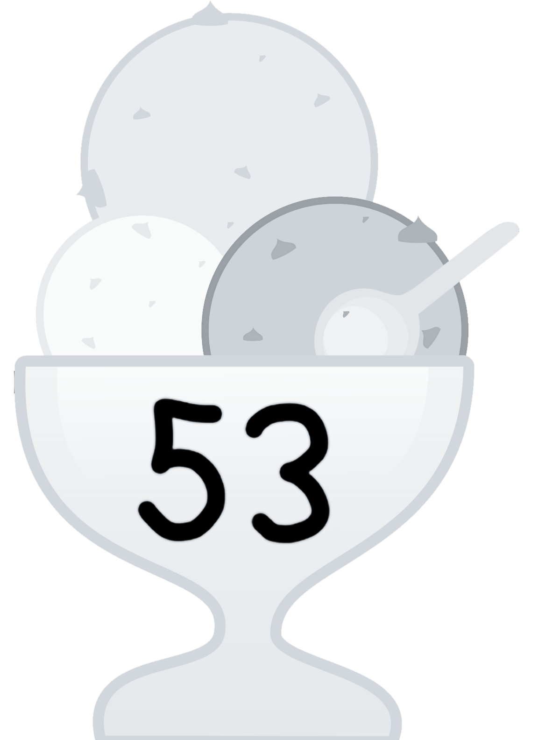
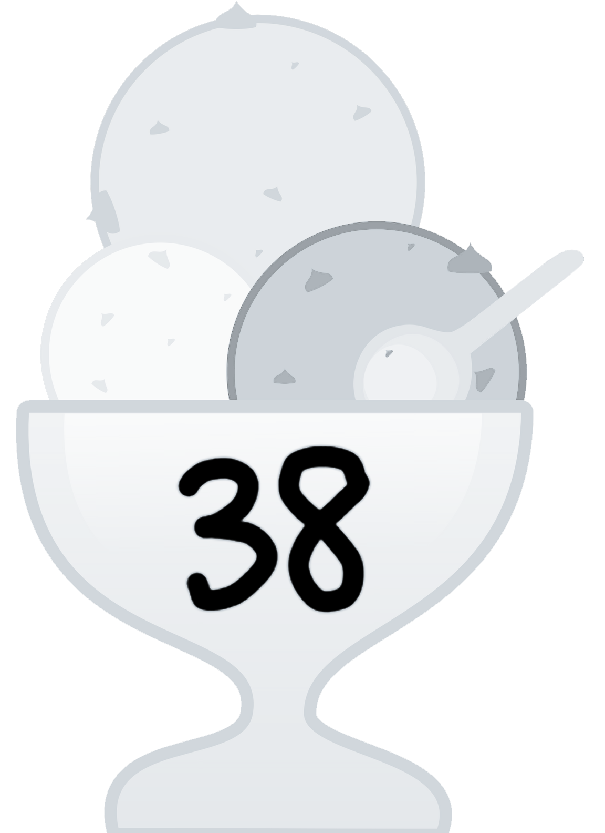
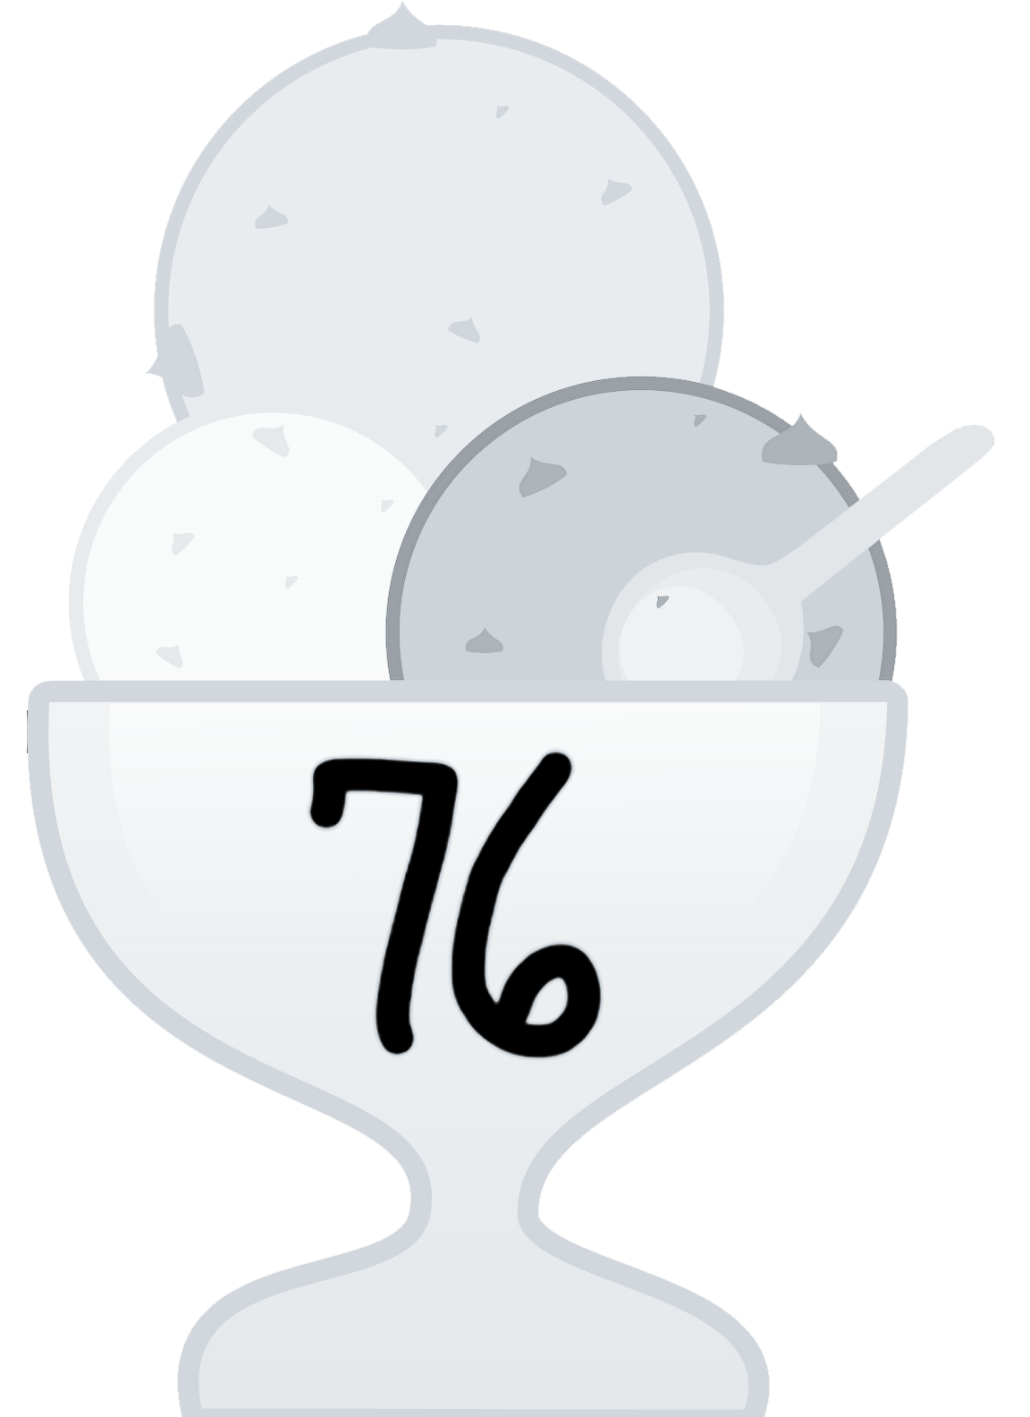
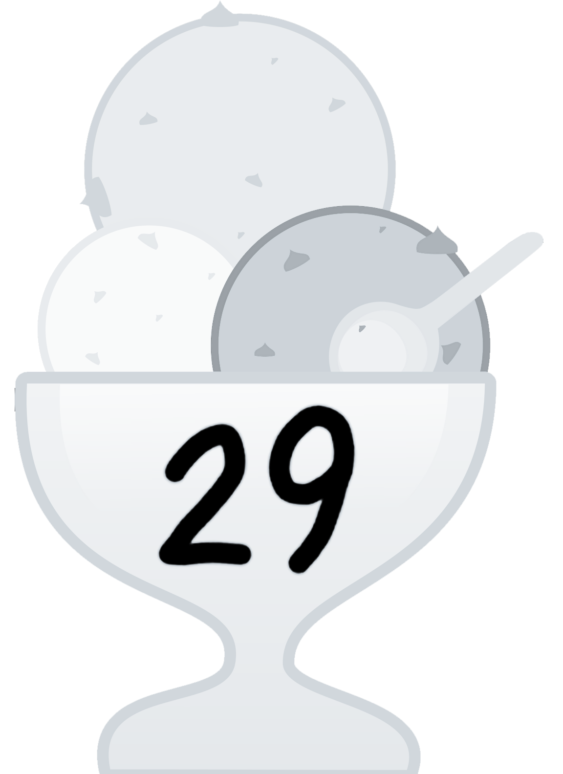


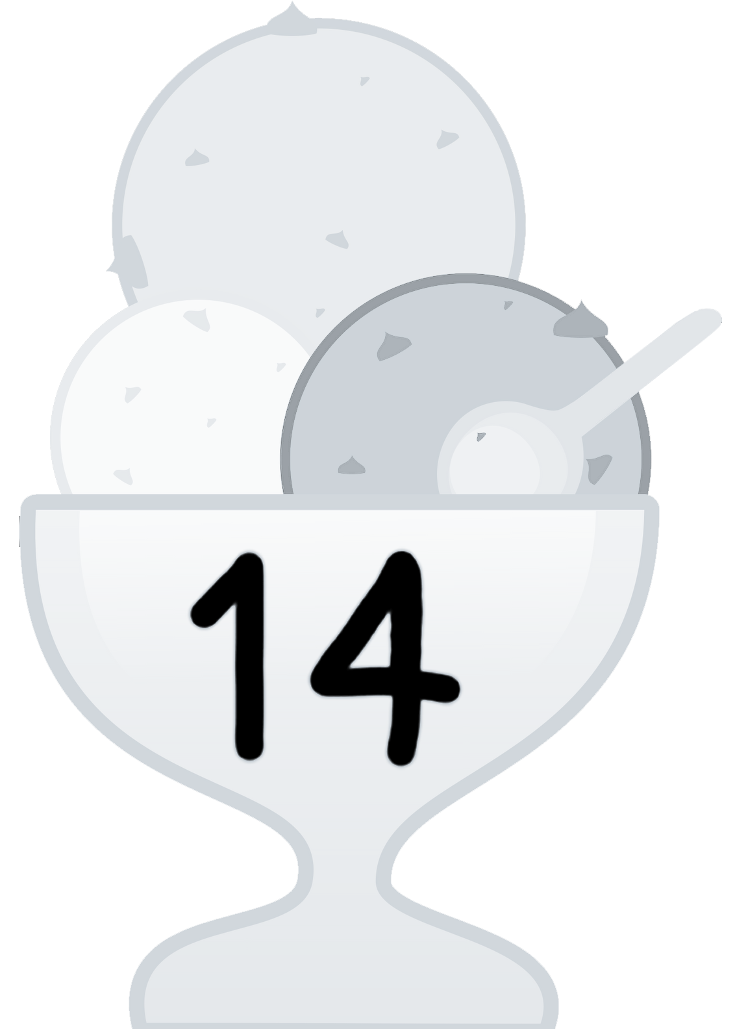

Insertion Sort
Insertion sort in action:
See full lab 5 slides for the complete animation

Slide 36
Merge Sort

Slide 37
Merge Sort (Top Down)
Take a list, split it in half
Recursively split both halves
Combine halves with merge function
Base case occurs when halves have length 1

Slide 38
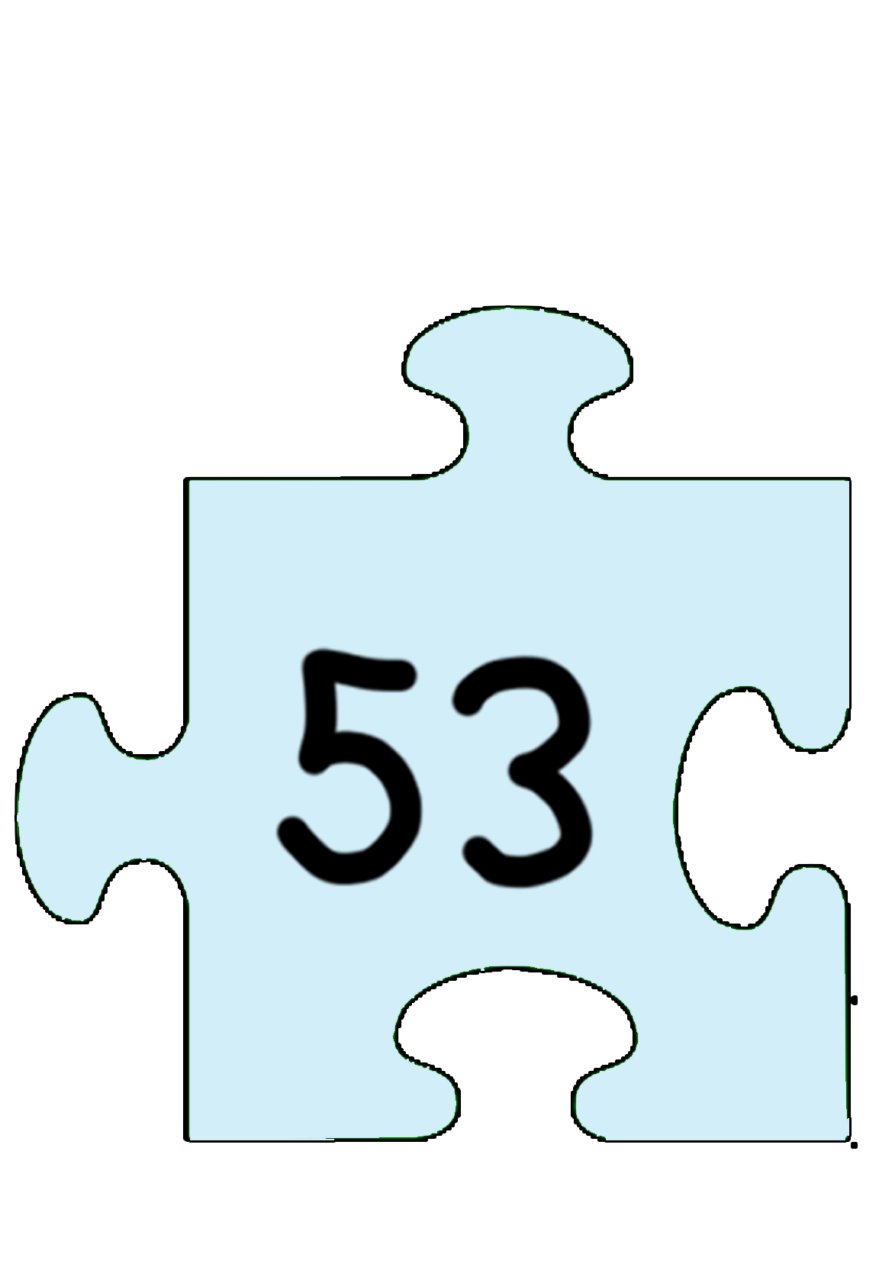
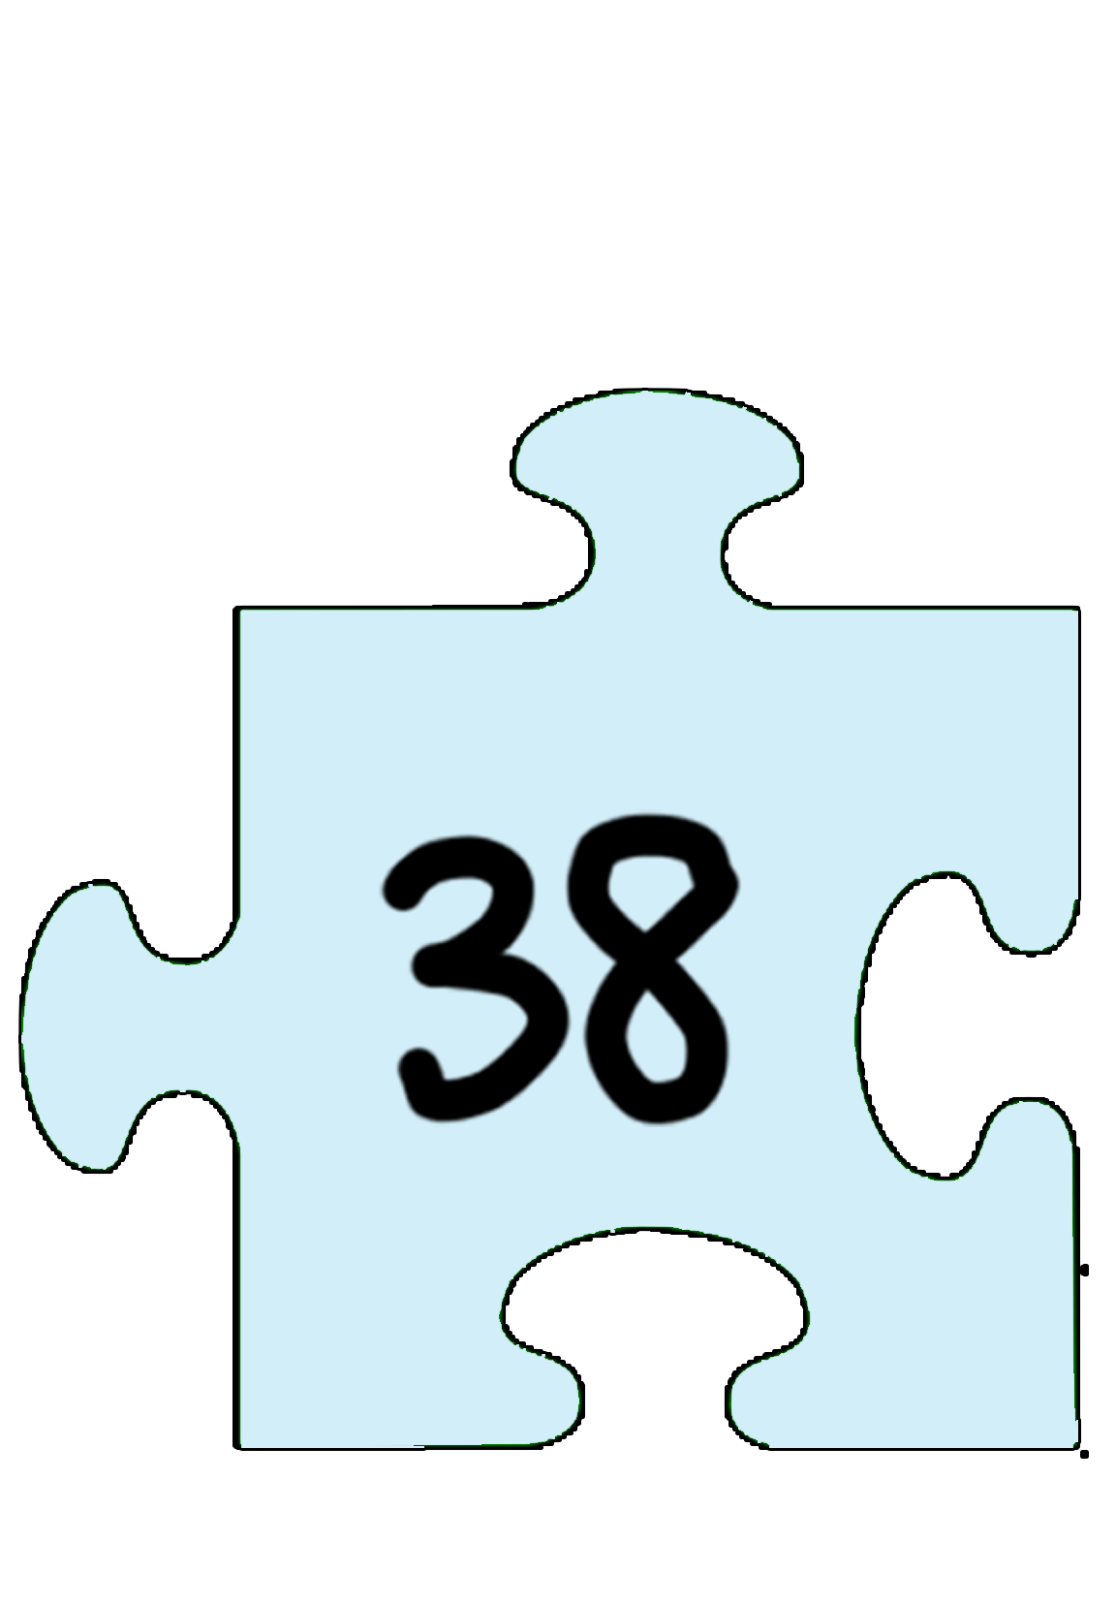
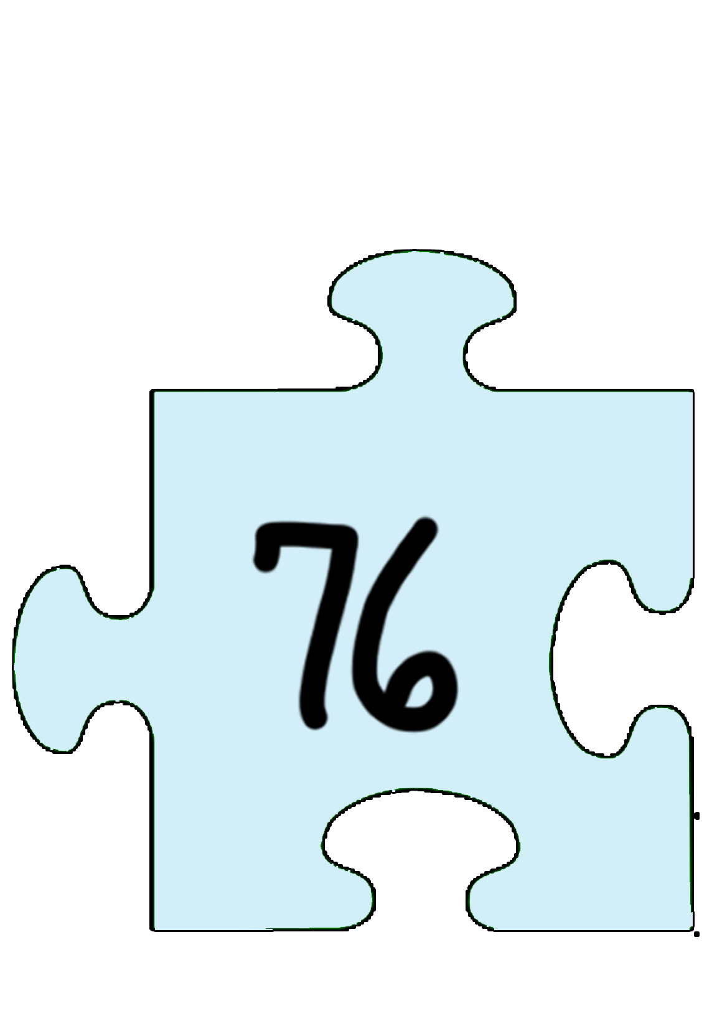
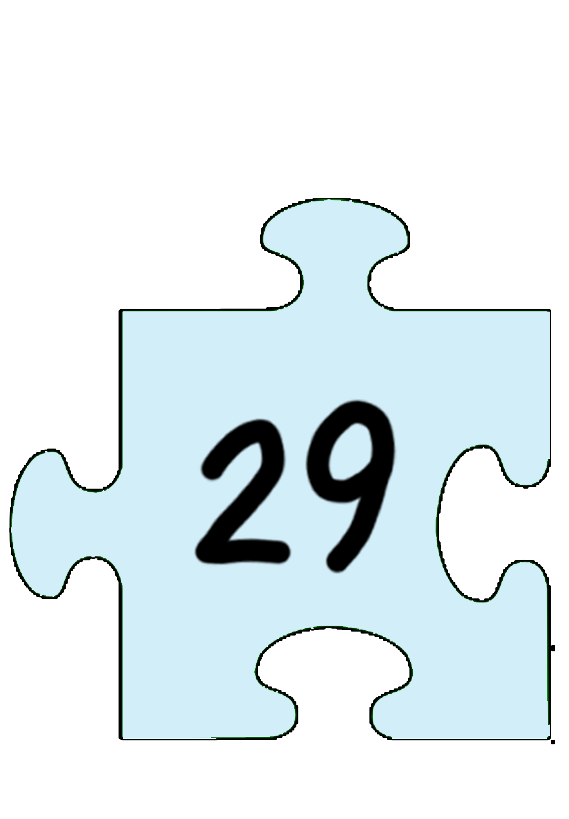
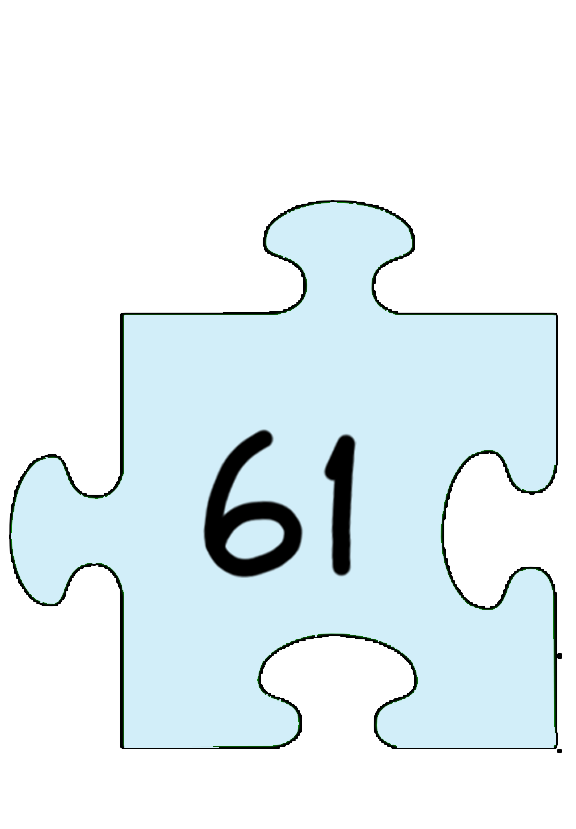
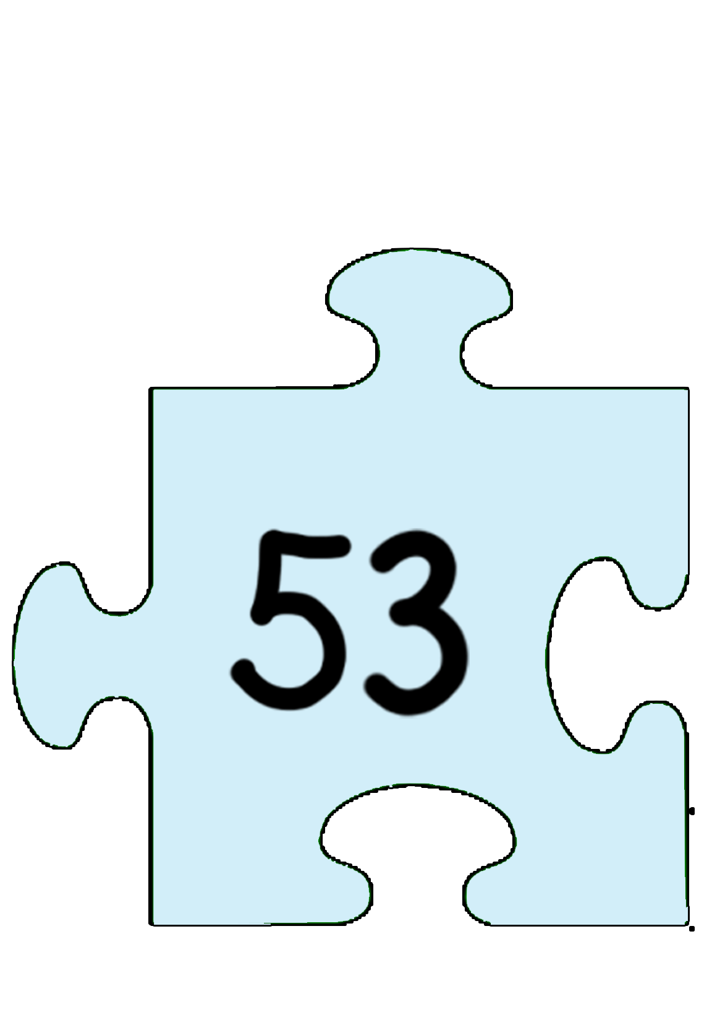
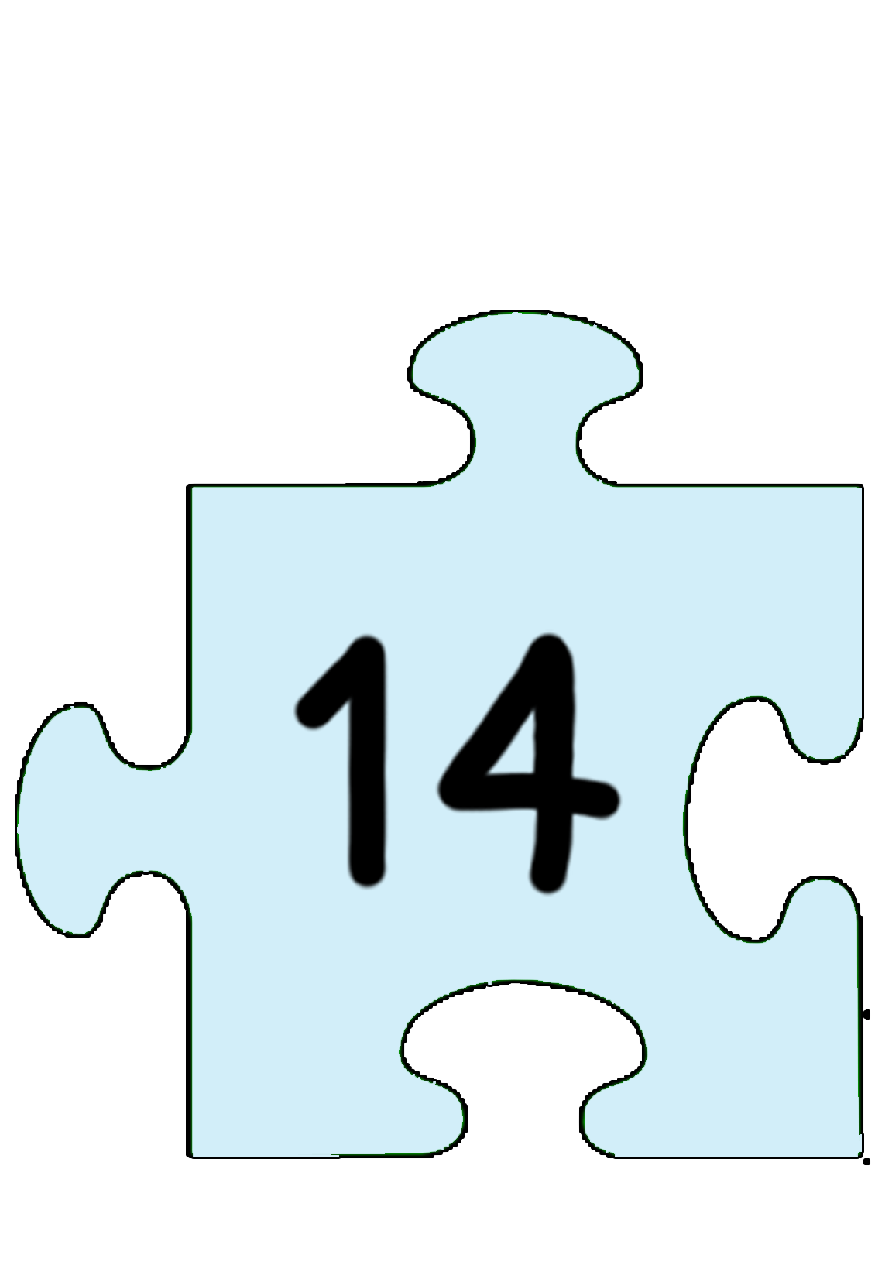
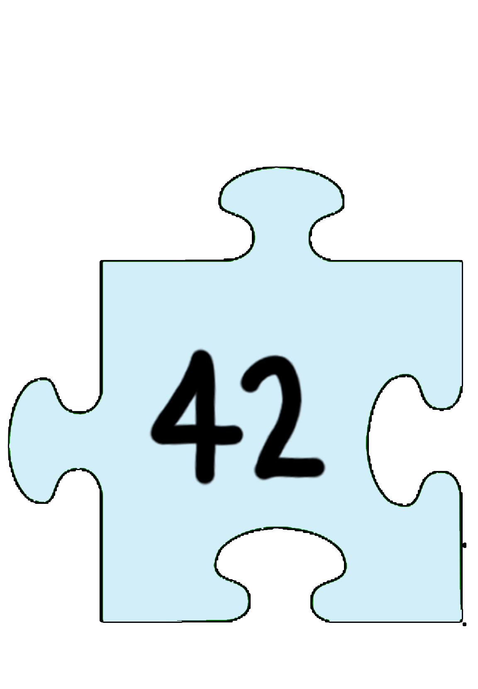
Merge Sort (Top Down)
Merge sort in action:
See full lab 5 slides for the complete animation

Slide 39
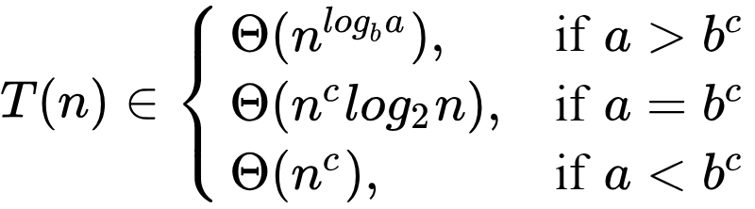
Merge Sort Complexity Analysis
mergesort(int [] a, int left, int right) {
if (right > left) {
middle = left + (right - left)/2;
mergesort(a, left, middle);
mergesort(a, middle+1, right);
merge(a, left, middle, right);
}
return;
}
T(n) = time to sort left half + time to sort right half + time to merge halves
= T(n/2) + T(n/2) + n
Therefore, we have: T(n) = 2 * T(n/2) + n, T(1) = 1

Slide 40
Merge Sort Complexity Analysis
mergesort(int [] a, int left, int right) {
if (right > left) {
middle = left + (right - left)/2;
mergesort(a, left, middle);
mergesort(a, middle+1, right);
merge(a, left, middle, right);
}
return;
}
By the Master Theorem, the complexity is Θ(n log n).
T(n) = time to sort left half + time to sort right half + time to merge halves
= T(n/2) + T(n/2) + n
Therefore, we have: T(n) = 2 * T(n/2) + n, T(1) = 1

Slide 41
Merge Sort
Characteristics of merge sort:
Comparison-based, divide-and-conquer algorithm.
Bottom-up and top-down algorithms available.
Algorithm: divide unsorted list into n sublists, each containing 1 element. Repeatedly merge sublists to produce new sublists until there is only one sublist (the final sorted list) left.
Stable as long as merge is stable. Not adaptive.
Memory is O(n) worst-case because most implementations merge into a separate container and then copy over to the original container.
Best Case | Average Case | Worst Case | Memory | Stable?
Ω(n log n) | Θ(n log n) | O(n log n) | O(n) | Yes

Slide 42
Quicksort

Slide 43
Quicksort
Characteristics of quicksort:
Comparison-based sorting algorithm.
Most implementations are unstable, except for complex in-place partitioning.
Often faster in practice than other n log n sorting algorithms.
Algorithm: pick a pivot from the list. Reorder list so that elements with values less than the pivot come before the pivot, while elements with values greater than or equal to the pivot come after it. After partitioning, the pivot is in the final position. Recursively sort the sub-list of elements with smaller values and the sub-list of elements with greater values.
Best Case | Average Case | Worst Case | Memory | Stable?
Ω(n log n) | Θ(n log n) | O(n²) | O(log n) | No*

Slide 44




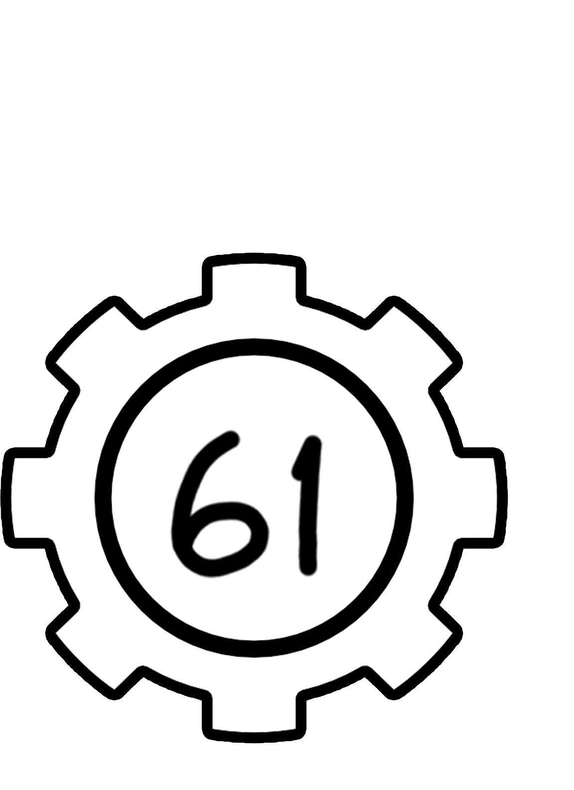



Quicksort
Quicksort in action (with last element as pivot):
See full lab 5 slides for the complete animation

Slide 45
Quicksort
What causes the worst-case O(n²) behavior?
What is the ideal pivot choice?
Why can’t we do this? What can we do instead?

Slide 46
Quicksort
What causes the worst-case O(n²) behavior?
When the smallest or largest element is chosen as the pivot every
time (the more uneven the partition, the worse the performance).
What is the ideal pivot choice?
Why can’t we do this? What can we do instead?

Slide 47
Quicksort
What causes the worst-case O(n²) behavior?
When the smallest or largest element is chosen as the pivot every
time (the more uneven the partition, the worse the performance).
What is the ideal pivot choice?
The median element (most evenly partitions the array - roughly equal
number of elements to both left and right of pivot.
Why can’t we do this? What can we do instead?

Slide 48
Quicksort
What causes the worst-case O(n²) behavior?
When the smallest or largest element is chosen as the pivot every
time (the more uneven the partition, the worse the performance).
What is the ideal pivot choice?
The median element (most evenly partitions the array - roughly equal
number of elements to both left and right of pivot.
Why can’t we do this? What can we do instead?
The median is often hard to find. To solve this, we can use median
sampling instead (e.g. take the median of a sample).

Slide 49
Summary of Sorts

Slide 50
Summary
Sort | Best | Average | Worst | Memory | Stable? | Adaptive?
Bubble | Ω(n) | Θ(n²) | O(n²) | O(1) | Yes | Yes
Selection | Ω(n²) | Θ(n²) | O(n²) | O(1) | No | No
Insertion | Ω(n) | Θ(n²) | O(n²) | O(1) | Yes | Yes
Heap | Ω(n log n) (distinct keys) | Θ(n log n) | O(n log n) | O(1) | No | No
Merge | Ω(n log n) | Θ(n log n) | O(n log n) | O(n) | Yes (if merge is stable) | No
Quick | Ω(n log n) | Θ(n log n) | O(n²) | O(log n) | No | No

Slide 51
Binary Search

Slide 52
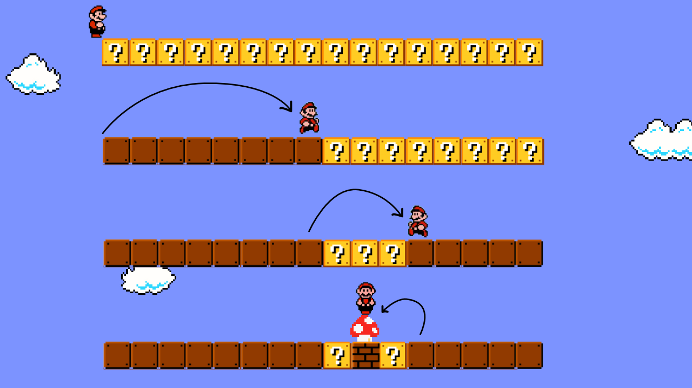
Binary Search Interview Problems
Binary search is a classic topic for interview problems.
Let’s look at a few problems that can be solved using binary search!

Slide 53
Binary Search Question #1
You are given an array that is first increasing and then decreasing. Find the maximum value of this array.
INPUT: arr[] = {8, 10, 20, 80, 100, 200, 400, 500, 3, 2, 1}
OUTPUT: 500
INPUT: arr[] = {1, 3, 50, 10, 9, 7, 6}
OUTPUT: 50
INPUT: arr[] = {10, 20, 30, 40, 50}
OUTPUT: 50
INPUT: arr[] = {120, 100, 80, 20, 0}
OUTPUT: 120

Slide 54
Binary Search Question #1
You are given an array that is first increasing and then decreasing. Find the maximum value of this array.
Solution:
perform a binary search
if middle element is greater than both of its adjacent elements, it is the maximum
if middle is greater than element to its right and smaller than element to its left, then max element lies to the left of mid (we are on decreasing side of the array)
if middle element is smaller than element to its right and greater than element to its left, then max element lies to the right of mid (we are on increasing side)

Slide 55
Binary Search Question #2
You are given a sorted array that is rotated at a certain position. Return the minimum element.
INPUT: arr[] = {5, 6, 1, 2, 3, 4}
OUTPUT: 1
INPUT: arr[] = {1, 2, 3, 4}
OUTPUT: 1
INPUT: arr[] = {2, 1}
OUTPUT: 1
INPUT: arr[] = {2, 3, 4, 5, 6, 1}
OUTPUT: 1

Slide 56
Binary Search Question #2
You are given a sorted array that is rotated at a certain position. Return the minimum element.
Solution:
perform a binary search
the minimum element is the only element whose
previous element is greater than it
check the middle element - if the element to its left is
greater than it, mid is the min
if the element to its left is less than or equal, it is not the
minimum; the minimum lies either in its left or right half
if the middle element is smaller than the last element, the
minimum lies in the left half; else, it lies in the right half
When you have narrowed the minimum down to two
elements, you can compare their values to find the min
Example:
{5, 6, 1, 2, 3, 4}
Mid element is 2. The element to the left is not greater than it. Hence, it is not the minimum.
Since 2 is smaller than 4 (the last element), it means the rotation point lies before mid. Therefore, we check the left half.

Slide 57
Binary Search Question #3
You are given a sorted array where every number occurs twice except for one number. Find this number that only appears once.
INPUT: arr[] = {1, 1, 6, 6, 9, 9, 22, 22, 26, 30, 30, 40, 40}
OUTPUT: 26
INPUT: arr[] = {1, 2, 2, 3, 3, 4, 4}
OUTPUT: 1
INPUT: arr[] = {1, 1, 2, 2, 3, 3, 4}
OUTPUT: 4
INPUT: arr[] = {281}
OUTPUT: 281

Slide 58
Binary Search Question #3
You are given a sorted array where every number occurs twice except for one number. Find this number that only appears once.
Key observation: if there were no odd element out, the first occurence of each number would be found at an even index, and the second occurrence would be found at an odd index.
This is true until we reach the odd one out! Once we reach this point, the opposite will be true (the first occurrence would be found at an odd index, the second at an even index). We will do a binary search to find the index of the odd one out.
If mid is even, check if a[mid] == a[mid + 1]
if mid is odd, check if a[mid] == a[mid - 1]
if these conditions hold, the odd one out must be found to the right, else it must be found to the left!

Slide 59
Bonus Interview Brain Teaser

Slide 60
Brain Teaser (Exercise for Home)
There are 2810 light bulbs lined up in a row in a long room. Each bulb has its own switch, and all switches are switched OFF at the beginning. The bulbs are numbered consecutively from 1 to 2810.
There are 2810 people lined up outside the entry door. Person 1 enters the room, flips the switch on every bulb, and exits. After person 1 leaves the room, person 2 enters and flips the switch on every second bulb (turning off bulbs 2, 4, 6...). After person 2 leaves, person 3 enters and flips the switch of every third bulb (changing the state on bulbs 3, 6, 9...). This continues until all 2810 people have passed through the room, where the 2810th person only flips the switch of the 2810th bulb.
After all 2810 people have exited the room, how many light bulbs are turned ON?
Suppose you have the ability to remove bulbs from the room in reverse order, first removing bulb 2810, then 2809, etc. What is the minimum number of bulbs you would have to remove for the number of bulbs that are turned ON to change?
Notes:
Answers: 53 and 2

Slide 61
Handwritten Problem

Slide 62
Handwritten Problem
Given a vector with n elements with values of either 0, 1, or 2, devise an O(n) algorithm to sort this vector. You must do this in a single pass of the vector. You may NOT copy items, create arrays or strings, or do any other memory allocation. Make sure your algorithm works for all cases.
You may use std::swap to swap two items in the vector.
BEFORE: arr[] = {2, 1, 0, 0, 2, 1, 2, 2, 0, 1, 1, 1, 0}
AFTER: arr[] = {0, 0, 0, 0, 1, 1, 1, 1, 1, 2, 2, 2, 2}
// sort a vector of 0s, 1s, and 2s in linear time
void sort012(vector<int>& nums);

Slide 63
Good Luck on the Exam!

